Slide 1

Advanced Studio #1 Capstone
GigMeIn
Finding a casual work like a one night stand
Project by
Hugo Santos and Petros Schilling

Slide 2
introduction

Slide 3
Introduction
who are we?
2 software developers with high standard goals
that want to be successful doing what we know best
to create intelligent and innovative solutions

Slide 4
Introduction
who are we?
how did we get started?
our project started in the class of Advanced Studio I
task to solve a problem
in an area we are passionate about
to develop an innovative application

Slide 5
Introduction
who are we?
how did we get started?
because this is something we see potential in
and that we actually liked
and saw the opportunity to become a real project
something beyond another university project
why choose this project?

Slide 6
Introduction
who are we?
how did we get started?
we want to empower students and employers
in creating a platform that connects them
in bringing more and fairer work opportunities
without get in the way of their commitments and priorities
why choose this project?
what’s our goal?

Slide 7
THE PROBLEM

Slide 8
THE PROBLEM
casual work is open to a limited number of people
opportunities are currently in a handful of places
groups tend to flood with unrelated topics
there is a very high competition gain access
however there are still unfilled opportunities
jobs are not presented to the right person
there is no way to confirm the reliability of the work
low job advert visibility due to the nature of the format
what is the problem?

Slide 9
The problem
what is the problem?
People spend hours/day looking for a job that:
Matches their timetable
Matches their skills
Have a fair wage
and end-up missing-out on fitting opportunities
how does it impact people?

Slide 10




The problem
what is the problem?
WhatsApp
Facebook
Telegram
Gumtree
Airtasker
WeChat
how does it impact people?
what are the current solutions?

Slide 11
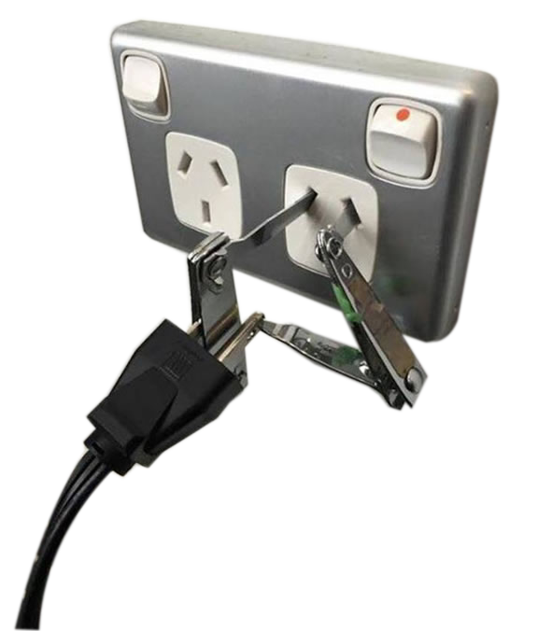
The problem
what is the problem?
The current solutions provide:
an unsuitable environment to deal with the problem
Basically, they can do the job, but
were never designed for it .
The famous 'gambiarra'
how does it impact people?
what are the current solutions?
why don’t they fit?

Slide 12
the research

Slide 13
THE RESEARCH
our hypothesis
we believed the target demographic was made of:
students and semi-skilled professionals
generally new young adults
people available/seeking for casual work
people looking for extra income

Slide 14
The RESEARCH
our hypothesis
we’ve confirmed our hypothesis of generally new young adults
our findings

Slide 15
The RESEARCH
our hypothesis
we’ve confirmed our hypothesis that there were:
a majority of students
our findings

Slide 16
The RESEARCH
our hypothesis
we’ve confirmed our hypothesis that there:
people available/seeking for casual work
our findings

Slide 17
The RESEARCH
our hypothesis
we’ve confirmed our hypothesis that there:
people looking for extra income
our findings
$0 - $400
$401 - $600
$601 - $800
$801 - $1000
> $1000

Slide 18









The RESEARCH
our hypothesis
we’ve confirmed our hypothesis that there:
most people are using these applications for driving their casual employment
our findings
Seek
Friends
Email
Airtasker
Telegram
None
Gumtree
Facebook
WhatsApp

Slide 19
The RESEARCH
our hypothesis
our findings
design an application based on:
user-experience and expectations of our target demographics
which features are people using from the other applications
our action-plan

Slide 20
THE solution

Slide 21
THE SOLUTION
an application that has as its main objective to:
introduce employees to employers
based on both type of users needs
centralise applicant management platform
reach unlimited number of users
draw better job post visibility
create a review system for creating trust
display relevant content only
what is the solution?

Slide 22
THE SOLUTION
what is the solution?
Centralised platform:
All will be listed in one and only one place
Unlimited users:
All users will have access
to the same list of jobs/employees
Job post visibility:
The jobs will keep their state without the need to repost
Review system:
Empowering users to tell how was their
experience in that relationship to other users
Relevant content only:
Jobs that fit the employee's timetable
Jobs that fit the employee's skill set
Jobs that fit the employee's interest based on IA learning
how are we going to tackle it?

Slide 23
The SOLUTION
what is the solution?
An employer posts a job
An employee applies for the job
The employer can accept or reject an application
The employee receive the application confirmation
Both users get access to the contact details
how are we going to tackle it?
how will it work?

Slide 24
roleplaying

Slide 25
roleplaying
first time using GigMeIn

Slide 26
roleplaying
first time using GigMeIn
day-to-day of a new GigMeIn user

Slide 27
roleplaying
first time using GigMeIn
day-to-day of a new GigMeIn user
day-to-day of an experience GigMeIn user

Slide 28
the TECH

Slide 29
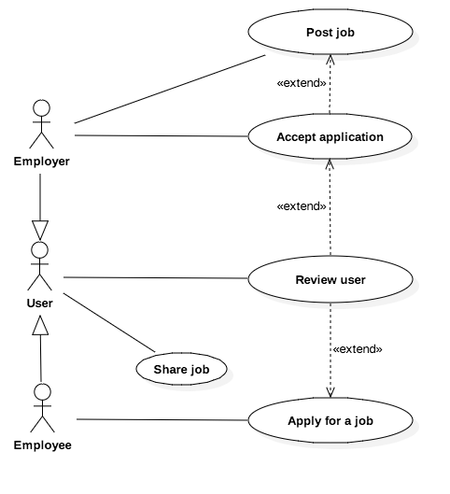
the TECH
use cases
A use case describes the interaction between:
an actor and a system
a system and another system
Its purpose is to identify:
the most elementary business processes
and how they are connected.

Slide 30
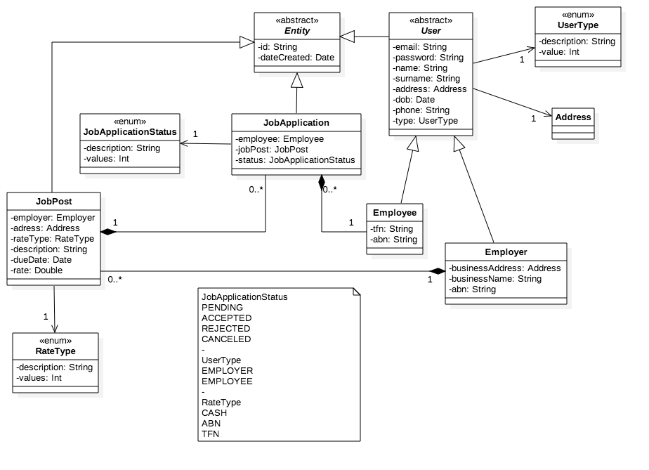
the TECH
A little sketch of our database is represented by the ER diagram
It describes how the that is structured inside the database
use cases
database architecture

Slide 31
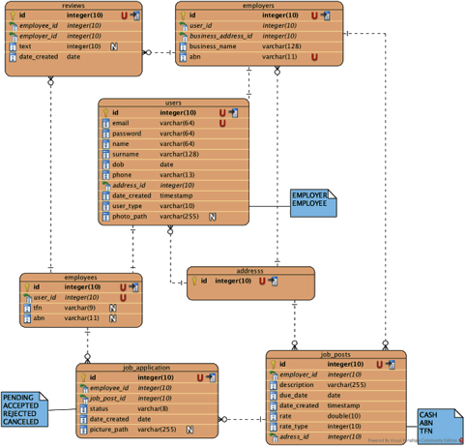
the TECH
Class diagram is one the most fundamental diagrams in UML.
It is used to capture the static structure of a software.
use cases
database architecture
class architecture

Slide 32
the TECH
Initial Platform: iOS
Language: Swift
Database: PostgreSQL or Firebase
Firebase pros:
very scalable and faster
Firebase cons:
Lack of experience, non relational data
PostgreSQL pros:
Lot of experience, relational data
PostgreSQL cons:
Not the best when dealing with large amounts of data
Why?
The project must be achievable in 3 months and
the know how has a lot of weight in this aspect
use cases
database architecture
class architecture
the technology

Slide 33
the business MODEL

Slide 34
the biz-model
premium job post push notification
\

Slide 35
the biz-model
premium job post push notification
user training & skilling recommendations

Slide 36
the biz-model
premium job post push notification
user training & skilling recommendations
schools & course advertisement

